Slide 1
Electrical Properties of Solution
Dr. Muhammed Shah Miran
Professor, Department of Chemistry
University of Dhaka, Dhaka 1000

Slide 2
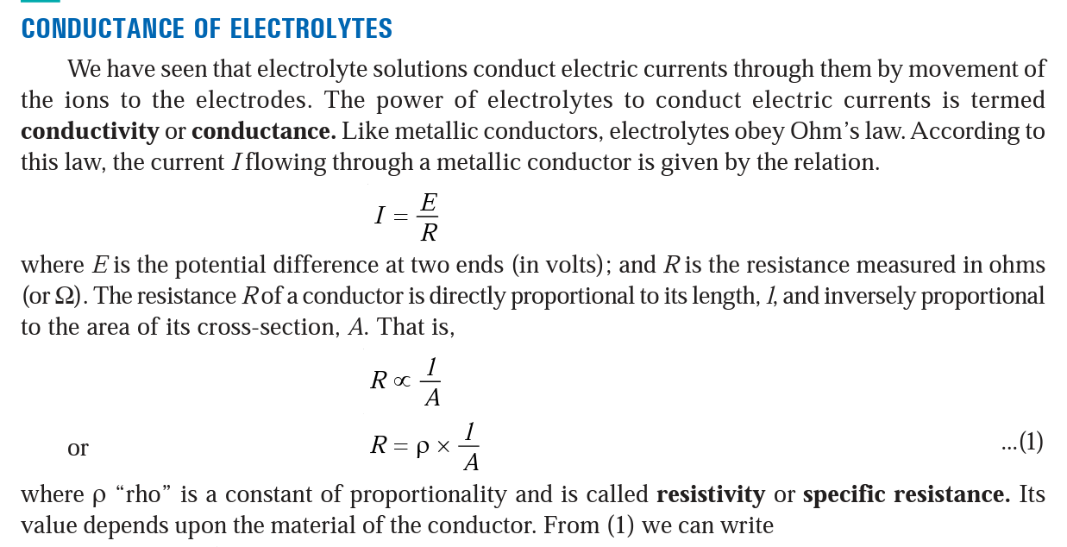

Slide 3
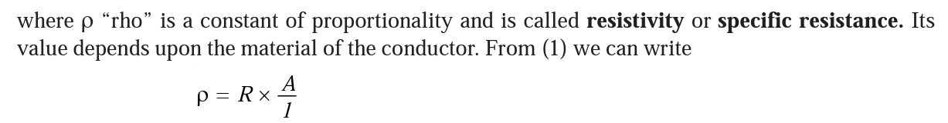
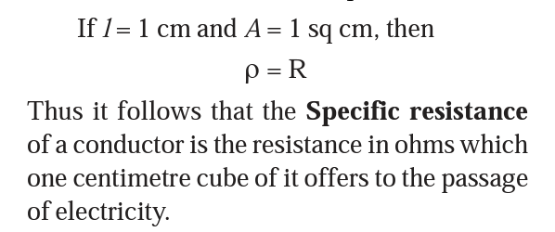

Slide 4
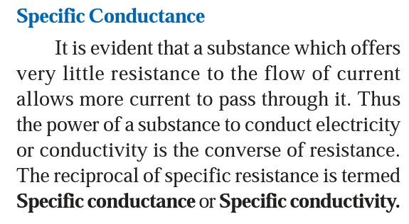
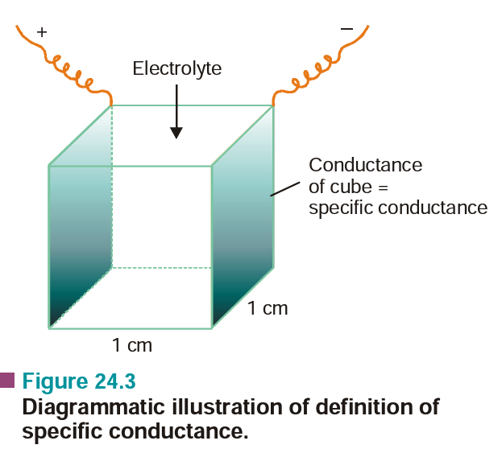
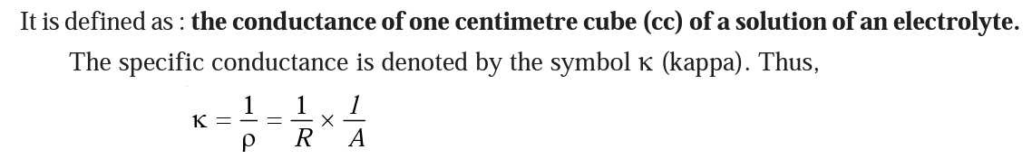

Slide 5
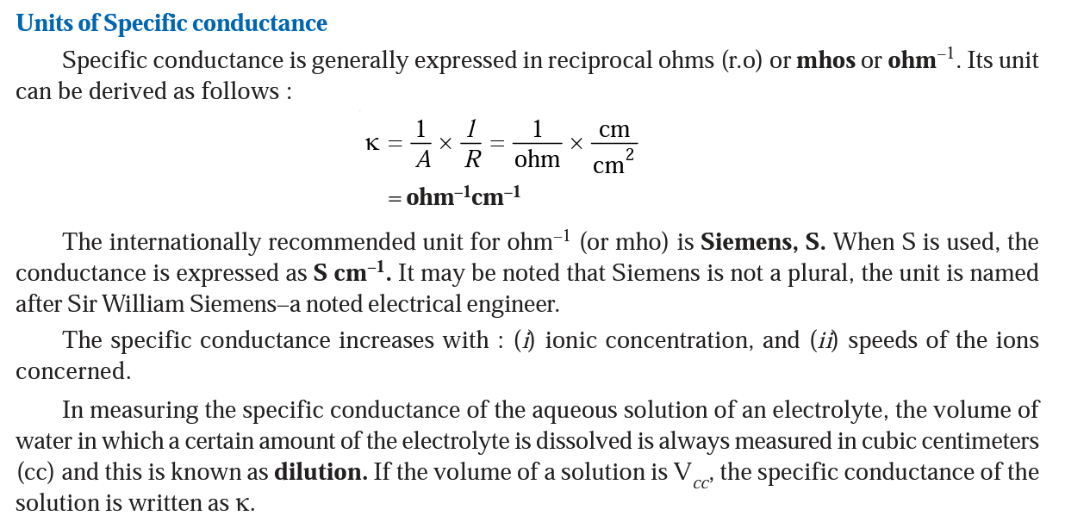

Slide 6
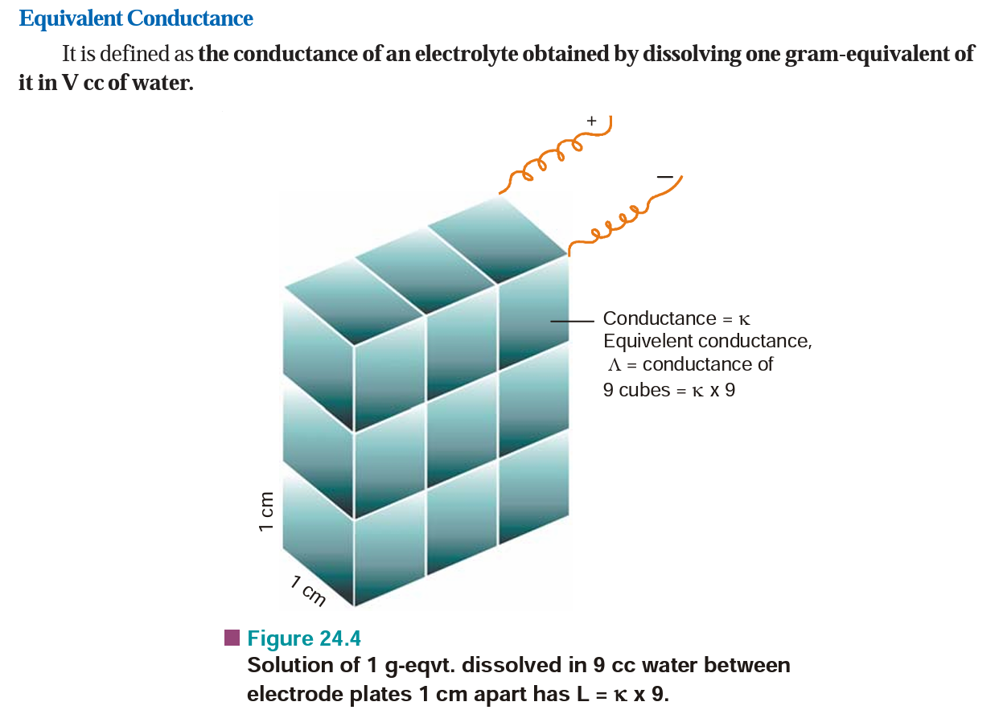

Slide 7
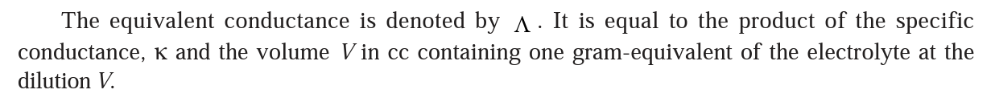
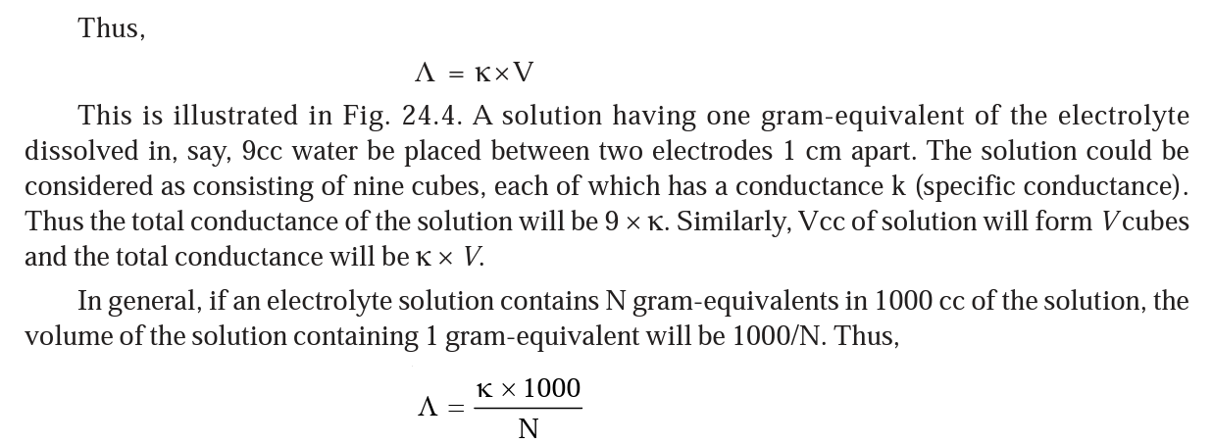

Slide 8
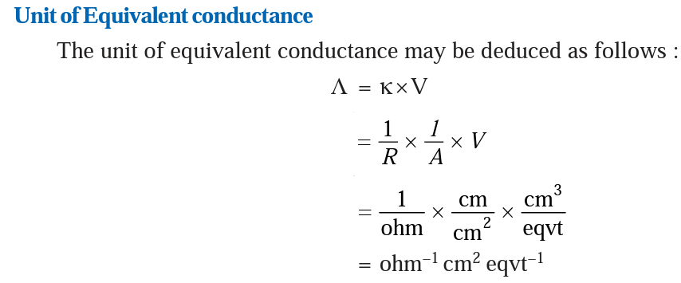

Slide 9
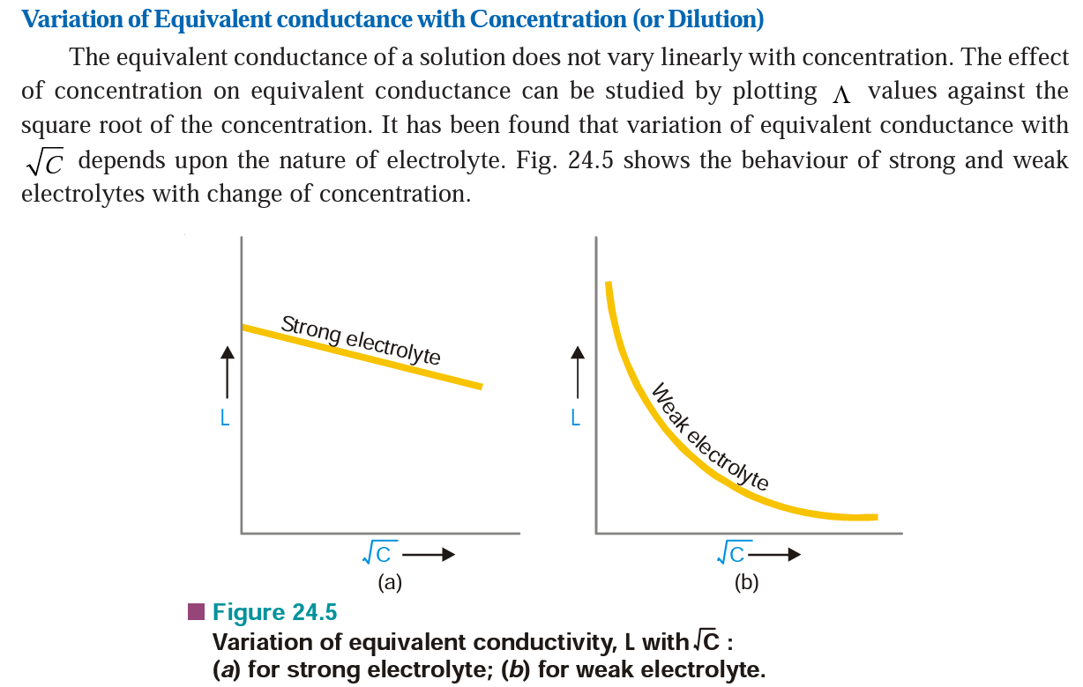

Slide 10
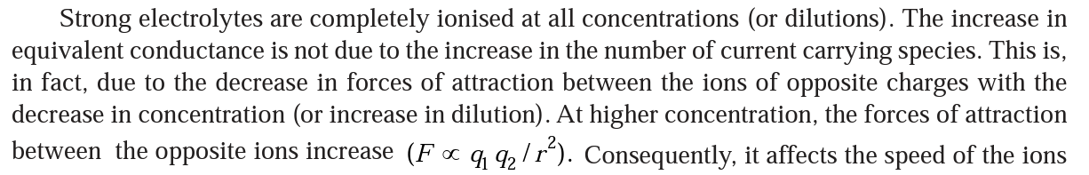

Slide 11
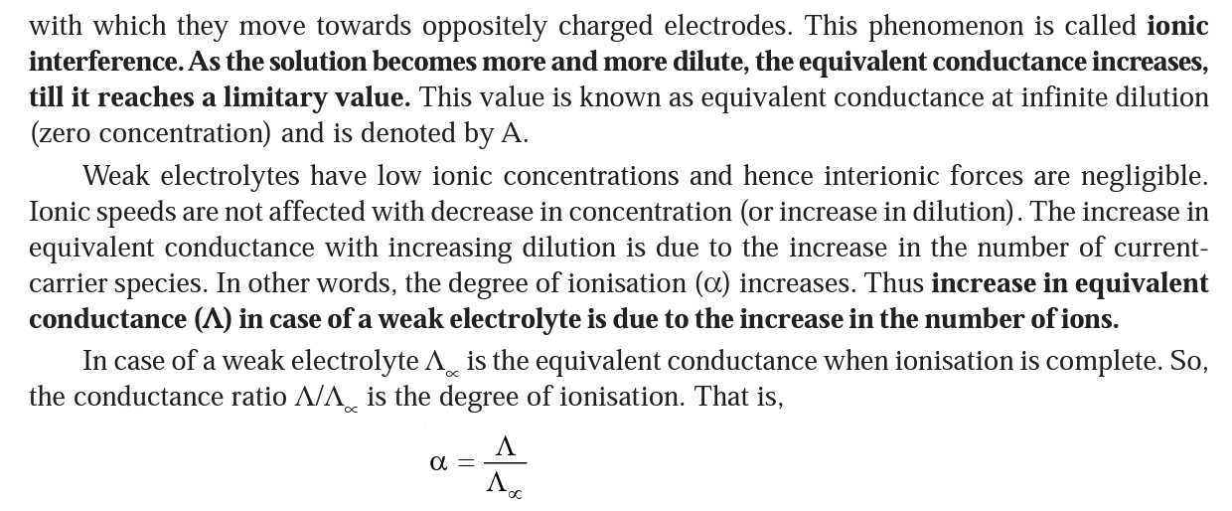

Slide 12
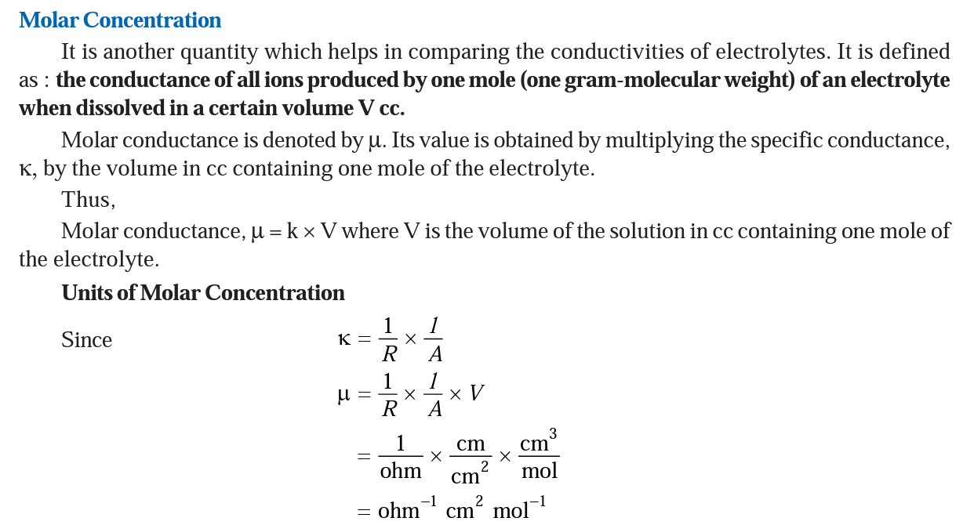

Slide 13
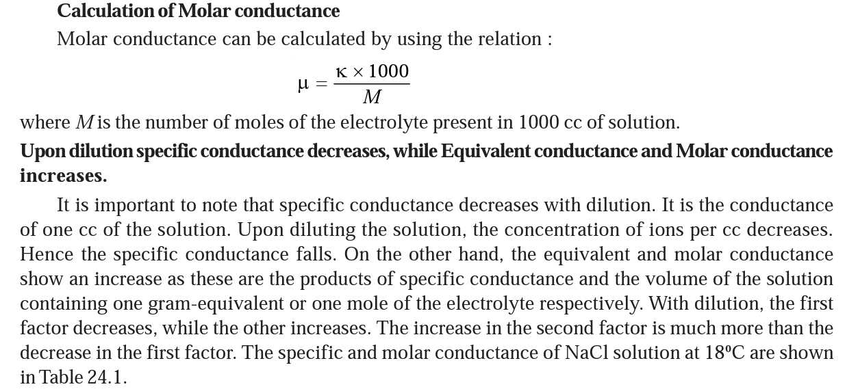

Slide 14
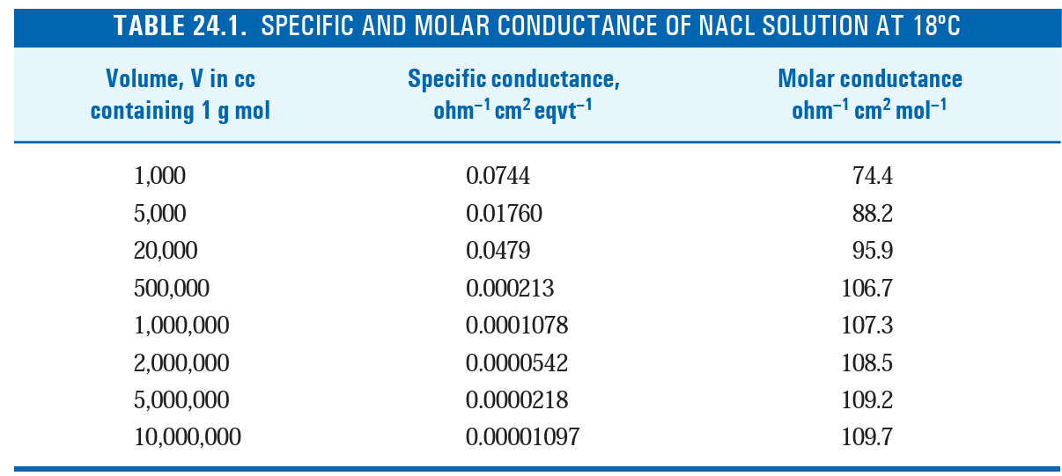

Slide 15
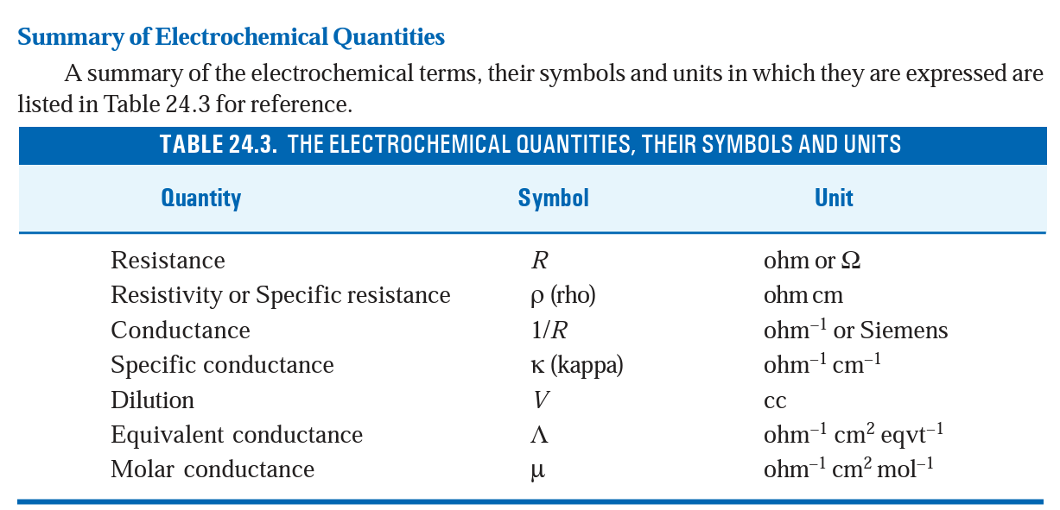

Slide 16
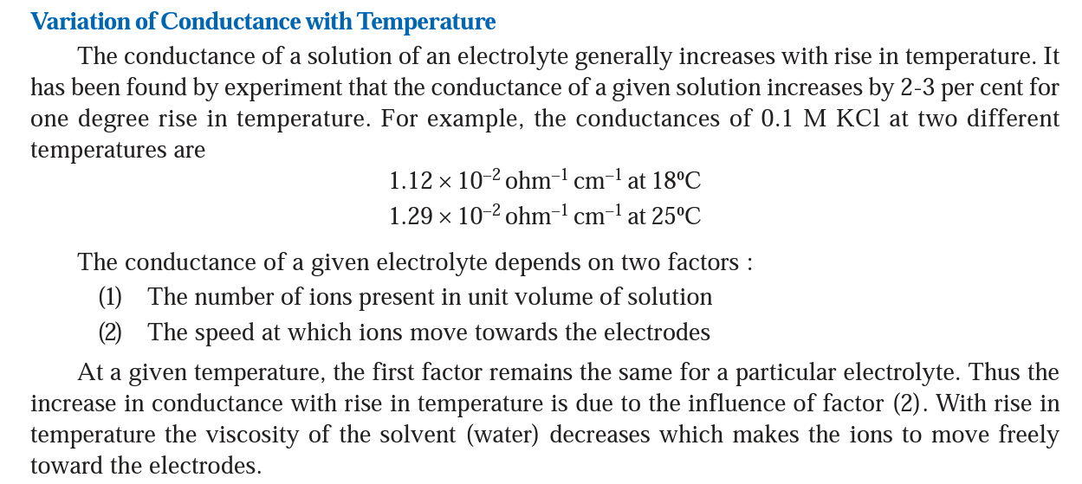

Slide 17
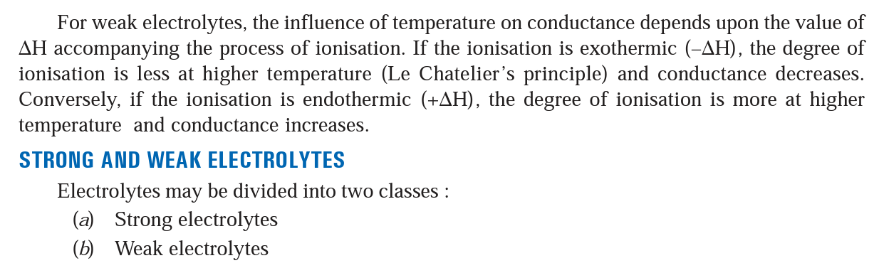

Slide 18
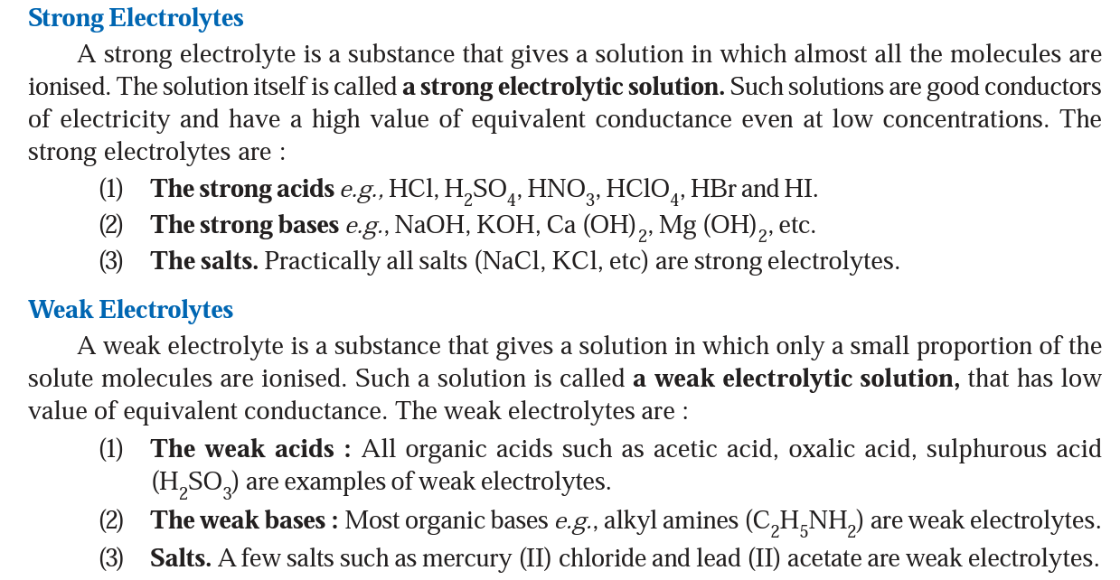

Slide 19
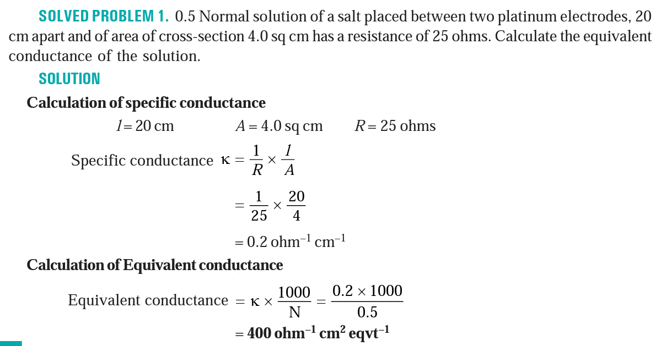

Slide 20
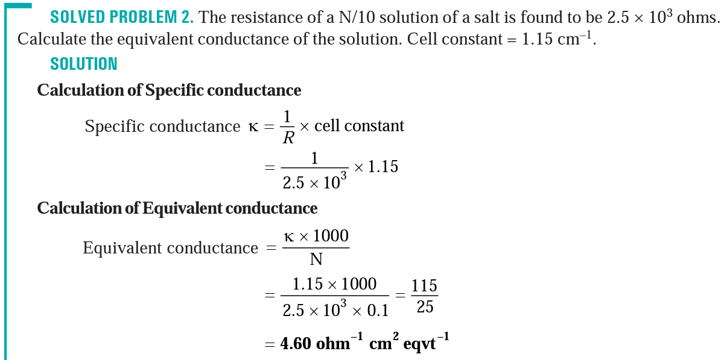

Slide 21
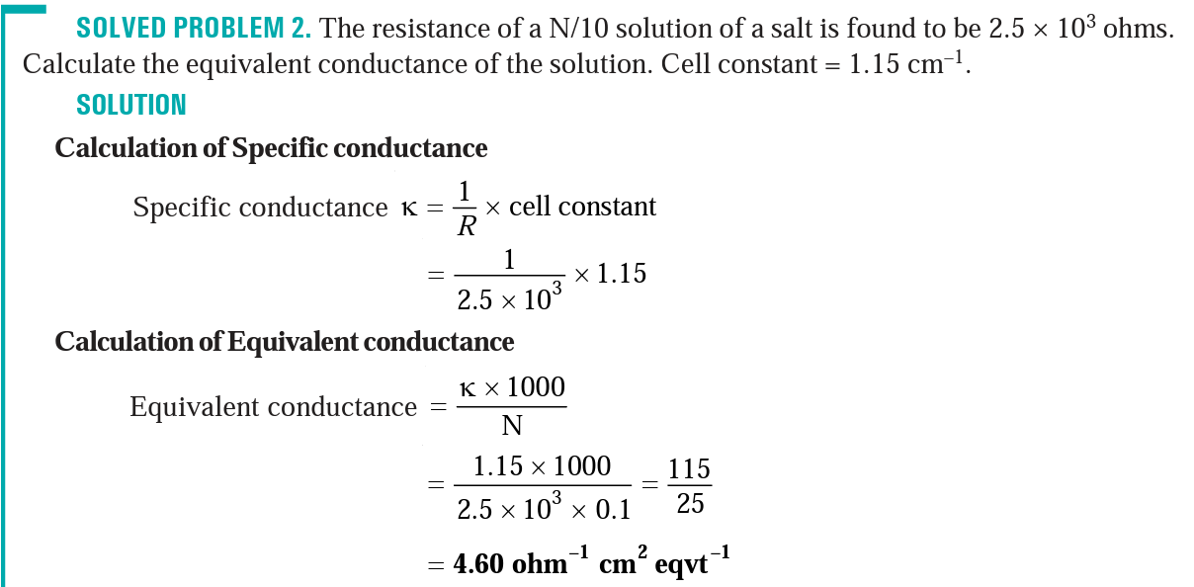

Slide 22
Which of the following have maximum molar conductivity.
(i) 0.08M solution and its specific conductivity is 2 × 10^{–2} ohms^{–1} cm^{–1}.
(ii) 0.1M solution and its resistivity is 50 ohms cm.

Slide 23
Define conductance, specific conductance, equivalent conductance and molar conductance.
Explain the factors affecting the conductance of an electrolyte.
On progressive dilution, specific conductance of an electrolyte decreases but molar conductance increases” discuss.
0.5 Normal solution of a salt placed between two platinum electrodes, 20 cm apart and of area of cross-section 4.0 sq cm has a resistance of 25 ohms. Calculate the equivalent conductance of the solution.
The resistance of a N/10 solution of a salt is found to be 2.5 × 10³ ohms. Calculate the equivalent conductance of the solution. Cell constant = 1.15 cm^{–1}.
The resistance of a 1N solution of salt is 50 ohms. Calculate the equivalent conductance of the solution, if the two platinum electrodes in solution are 2.1cm apart and each having an area of 4.2cm².
Which of the following have maximum molar conductivity.
(i) 0.08M solution and its specific conductivity is 2 × 10–2 ohms^{–1} cm^{–1}.
(ii) 0.1M solution and its resistivity is 50 ohms cm.

